Slide 1
Webviz-4D Drogon
Internal - RGS
20.12.2021

Slide 2
Webviz-4D Vision: Make 4D seismic results easily available for Petec assets
For all Petec personnel and license partners,
Who would like to see how reservoir production/injection has changed the seismic response,
Our WebViz-4D application is a visualization tool,
That makes 4D seismic data easily available together with relevant well information,
Unlike dedicated geophysical applications,
Our product is easy to use and available for all Petec disciplines
Building blocks:
Webviz Subsurface* components
Attribute maps based on FMU workflow
Well and surface handling by XTGeo
Field specific configurations
Part of Next Generation Reservoir Monitoring Data Flow (NGRMDF) project supported by Johan Sverdrup, Grane, Snorre and Johan Castberg
*) https://webviz-subsurface-example.azurewebsites.net/
Notes:
Webviz Subsurface and XTGeo are open source packages
Visualization part of WebViz-4D will also be made open source
Goal: standard solution that can be used by all relevant fields in Equinor

Slide 3
Release Notes (10.12.2021)
This version of Webviz-4D includes timelapse maps from the FMU-ensemble:
/scratch/coviz_sn/eza/coviz_SN_NGM_2021a_r000_b
Linux (RGS Stavanger) version :
Open a terminal window
Type:
cd /project/snorre/reservoirmodels/ff/share/webviz/prod
/launch_webviz_4d

Slide 4
Application overview
Documentation
Observed and simulated timelapse maps
Only observed timelapse maps
Table with wellbore overview
Interactive plotting of injected and produced volumes in the incremental 4D intervals
Tables with production volumes in the incremental 4D intervals
Tables with injection volumes in the incremental 4D intervals

Slide 5
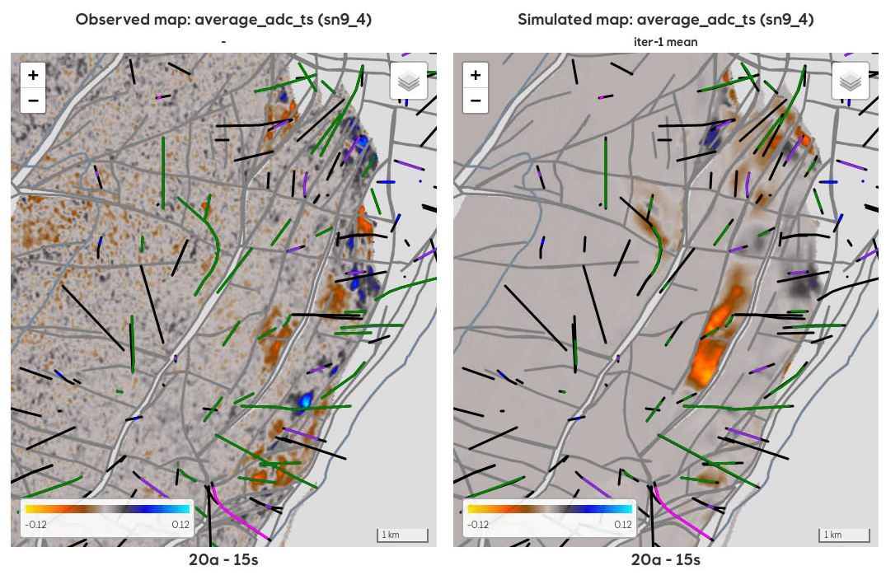
Webviz-4D Main functionality
Display observed and simulated timelapse maps together with well trajectories
Option to display only producers and injectors in a selected 4D interval
Display tooltip when pointing at a well with information about production/injection volumes
Table with overview of well and production data information
Interactive plotting of injected and produced volumes in 4D intervals
Tables with overview of injected and produced volumes

Slide 6
Known Issues (01.12.2021)
The performance when using the selectors to switch between the different maps is still not satisfactory.
It might be difficult to display the tooltip that will display some information about a well since it is necessary to move the cursor very close to the selected well trajectory before the tooltip appears.

Slide 7
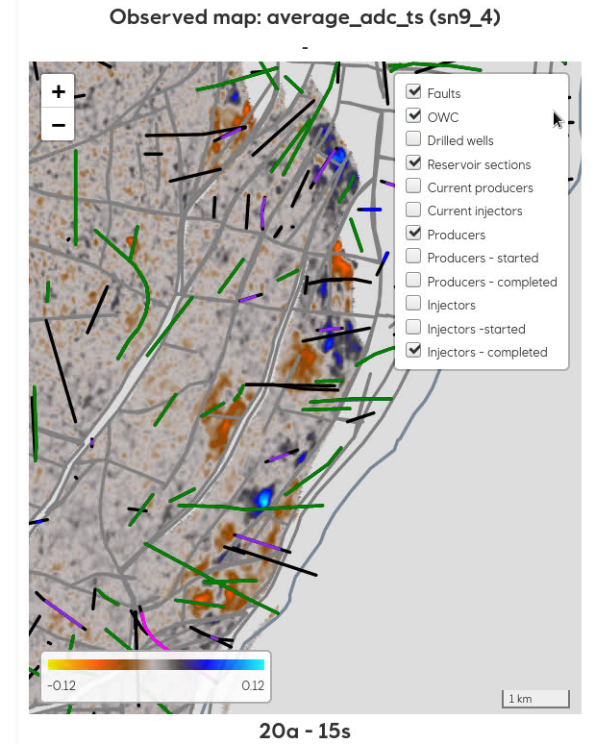
Webviz-4D Well layers
Drilled wells
Whole wellpaths for all drilled wells
Reservoir sections
Wellpaths below top reservoir (for all drilled wells)
Current producers
Wellpaths below top reservoir (for currently active producers)
Current injectors
Wellpaths below top reservoir (for currently active injectors)
Producers
Wellpaths below top reservoir for production wells in the selected 4D interval
Producers - completed
Top and base of completed/perforated part of wellpaths for production wells (in the selected 4D interval)
Injectors
Wellpaths below top reservoir for injection wells in the selected 4D interval
Injectors - completed
Top and base of completed/perforated part of wellpaths for injection wells (in the selected 4D interval)

Slide 8
Hints and tricks
Well layers in Observed and simulated maps
When checking on a well layer, the new layer will always be displayed on top of any existing layers. This means e.g., that the «Drilled wells» layer will always cover any of the production/injection layers (if already displayed). However; displaying any of the “completed” layers on top of «Drilled wells» or «Reservoir sections» can be quite useful.
Filter rows or sort table in Wellbore overview or any of the volume tables
Filtering is done by enter a text to be matched in the second row of a column, e.g.; “production” in the “Type” column or “2020” in the “Start oil prod.” column
Sorting of the table is done by clicking at the icon to the left in a column header. The icon will change to indicate whether the sorting is ascending or descending .
Filters in production/injection plots
Several options (wells or fluids) can be selected by either pressing Ctrl or Shift when clicking at another well or fluid type.

Slide 9
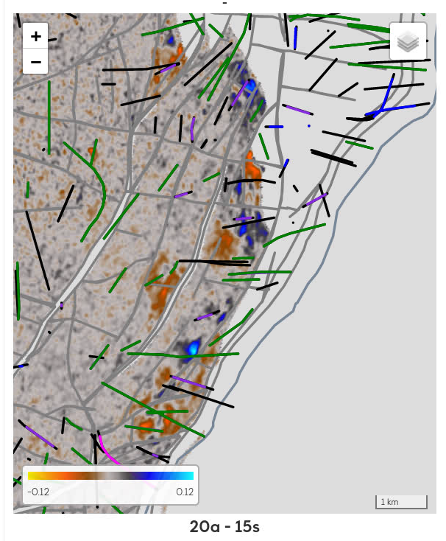
Input data
FMU-project
SMDA
Wellbore trajectories
Oil producers
Water injectors
Gas injectors
WAG injectors
Well headers
Well trajectories
Timelapse maps
(observed/simulated)
Top reservoir depth map
Fault polygons (zones)
Wellbore metadata
SSDL
Completion data
Completion information
Perforation intervals
Field outline
Fault polygons
Maps metadata
PDM
Production data
Min-/max-values
Display settings
Injection data
Daily production-/injection volumes

Slide 10
Backlog (high priorities)
New map viewer component
Improved annotations/tooltip
Display well logs (sylinders)
Display well picks
Display production/injection pie-charts
Improved performance
…
Seismic cross-sections
Select inline/xline
Selelct well fence
Digitize random line
Documentation
Improve code quality
Enhancements
Selector linking
Table plot with daily rates (selected interval)
Planned wells from Compass
Different default 4D intervals
Turn on/off selected wells
Include flooding maps
…

Slide 11
Connections/links to other projects/activities
Webviz (TDI) – Anders Fredrik Kiær
Development of the Webviz framework and specialized plugins
Sumo (TDI) – Per Olav Eide Svendsen
Sumo is a cloud-native solution for managing, standardizing and sharing data produced by subsurface predictive models
FMU: Simplify and improve quality – Iain Shepherd
FMU metadata
OneSeismic – Renaud Laurain
Next-generation seismic in the cloud
4D seismic reporter (JS Digital projects) – Cedric Fayemendy
Consistent and systematic reporting of 4D observations
Efficient Subsurface Characterization (TDI) - Jostein Myking Kjærefjord
DynaGeo (Integrated Analysis and Visualization of Dynamic Data for reservoir characterization)
MARS (TDI) - Ola-Petter Normann Munkvold
Machine-Assisted Reservoir Surveillance
SeisTiles – Øyvind Skjæveland
Tiles as a basis for digitalization of subsurface logic involving seismic data
…

Slide 12
Timelapse files
Timelapse files | Internal – Linux (06.12.21)
Observed timelapse files | 2 496
Simulated timelapse files - realizations | 1 449 984
Simulated timelapse files - statistics | 49 152
All timelapse files | 1 501 632

Slide 13
Timelapse maps overview
Attribute | Observed | Simulated
average_adc_ts | ✓ | ✓
average_dts | ✓ | ✓
timeshift | ✓ | ✓
average_ai | ✗ | ✓
average_dts | ✗ | ✓
ecl_average_pressure | ✗ | ✓
ecl_average_sgas | ✗ | ✓
ecl_average_soil | ✗ | ✓
ecl_average_swat | ✗ | ✓
pem_average_pressure | ✗ | ✓
pem_average_sgas | ✗ | ✓
pem_average_swat | ✗ | ✓

Slide 14
Surface/zone overview
Surface/zone name | Observed | Simulated
basereservoir | ✓ | ✓
overburden | ✓ | ✓
sn10_1 | ✓ | ✓
sn10_2 | ✓ | ✓
sn10_3 | ✓ | ✓
sn10_4 | ✓ | ✓
sn11 | ✓ | ✓
sn11_1 | ✓ | ✓
sn11_2 | ✓ | ✓
sn1_4 | ✓ | ✓
sn2_5 | ✓ | ✓
sn3_4 | ✓ | ✓
sn4_2 | ✓ | ✓
sn5_3 | ✓ | ✓
Surface/zone name | Observed | Simulated
sn6_2 | ✓ | ✓
sn6_4 | ✓ | ✓
sn7_2 | ✓ | ✓
sn7_4 | ✓ | ✓
sn8_1 | ✓ | ✓
sn8_2 | ✓ | ✓
sn9_1 | ✓ | ✓
sn9_2 | ✓ | ✓
sn9_3 | ✓ | ✓
sn9_4 | ✓ | ✓
snLL | ✓ | ✓
snML3 | ✓ | ✓
snML4 | ✓ | ✓
snll | ✗ | ✓
snml3 | ✗ | ✓
snml4 | ✗ | ✓
topgrid | ✗ | ✓

Slide 15
4D intervals overview
Interval
1997-07-02-1992-08-01
2001-07-02-1997-07-02
2005-07-02-2001-07-02
2006-07-02-2005-07-02
2009-07-02-2006-07-02
2012-07-02-2009-07-02
2014-11-02-2014-06-02
2015-06-15-2014-11-02
2015-10-15-2015-06-15
2016-06-02-2015-10-15
2017-06-02-2016-06-02
2018-06-15-2017-06-02
2018-10-15-2018-06-15
2019-06-02-2018-10-15
2019-09-15-2019-06-02
2020-06-02-2019-09-15
2020-10-02-2020-06-02
Interval
2005-07-02-1997-07-02
2006-07-02-1997-07-02
2006-07-02-2001-07-02
2009-07-02-1997-07-02
2012-07-02-1992-08-01
2012-07-02-1997-07-02
2012-07-02-2006-07-02
2014-06-02-1997-07-02
2015-06-15-2014-06-02
2015-10-15-2014-06-02
2015-10-15-2014-11-02
2016-06-02-2014-06-02
2016-06-02-2015-06-15
2017-06-02-2014-06-02
2017-06-02-2015-06-15
Interval
2018-06-15-2014-06-02
2018-06-15-2015-06-15
2018-10-15-2014-06-02
2018-10-15-2015-06-15
2018-10-15-2017-06-02
2019-06-02-2014-06-02
2019-06-02-2015-06-15
2019-06-02-2018-06-15
2019-09-15-2014-06-02
2019-09-15-2015-06-15
2020-06-02-2014-06-02
2020-06-02-2015-06-15
2020-06-02-2019-06-02
2020-10-02-2014-06-02
2020-10-02-2015-06-15
2020-10-02-2019-09-15

Slide 16
Ensemble overview
Iterations | Observed | Simulated
Iter-1 | ✓ | ✓
Realization/statistics | Observed | Simulated
realization-0 | ✓ | ✓
realization-1 – realization-119 | ✗ | ✓
mean | ✗ | ✓
p10 | ✗ | ✓
p90 | ✗ | ✓
std | ✗ | ✓

Slide 17
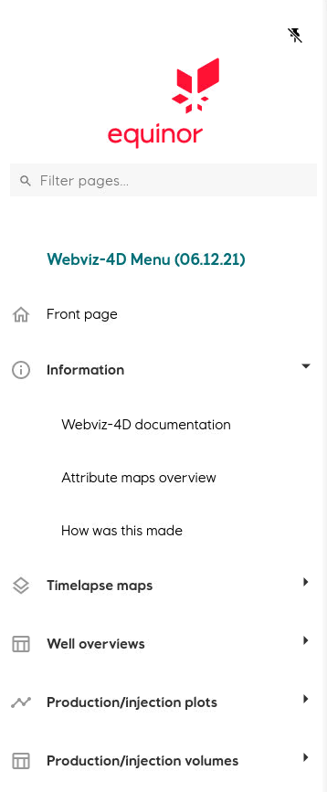
Exercise 1: Start and stop Webviz-4D
Open a terminal window and type:
cd /project/snorre/reservoirmodels/ff/share/webviz/prod
./launch_webviz_4d
Expand the menu groups and check out the individual menu items
Close the application:
Close the web browser (or just the Webviz-4D tab)
Press CTRL + C in the terminal window to stop the application.

Slide 18
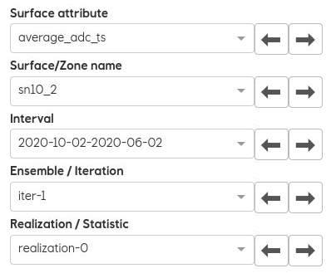
Exercise 2: Compare observed and simulated maps
Open a terminal window and type:
cd /project/snorre/reservoirmodels/ff/share/webviz/prod
./launch_webviz_4d
Select Timelapse maps – Observed and simulated maps
Checkout the selector options (for both observed and simulated maps)
Select some of the same maps as used in Coviz and try to zoom and pan
Scroll in realizations and also check the statistical maps

Slide 19
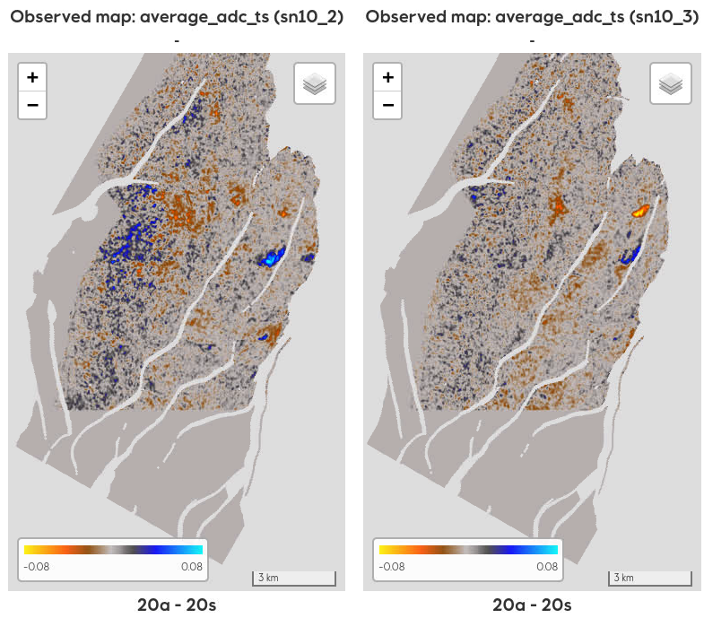
Exercise 3: Compare only observed maps
Select Timelapse maps – Observed maps
Compare the 4D responses in different zones by selecting the same attribute in all 3 views, but with different zone
Check time development by selecting the same attribute in all 3 views, but with different 4D interval

Slide 20
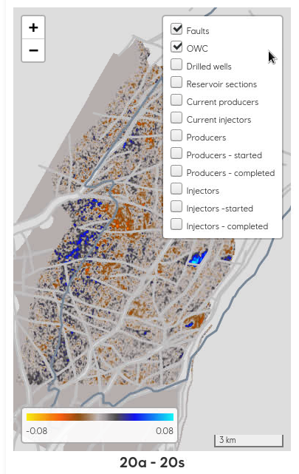
Exercise 4: Well layers
Drilled wells
Whole wellpaths for all drilled wells
Reservoir sections
Wellpaths below top reservoir (for all drilled wells)
Current producers
Wellpaths below top reservoir (for currently active producers)
Current injectors
Wellpaths below top reservoir (for currently active injectors)
Producers
Wellpaths below top reservoir for production wells in the selected 4D interval
Producers - started
Top and base of completed/perforated part of wellpaths for production wells that has started in the selected 4D interval
Producers - completed
Top and base of completed/perforated part of wellpaths for production wells (in the selected 4D interval)
Injectors
Wellpaths below top reservoir for injection wells in the selected 4D interval
Injectors - started
Top and base of completed/perforated part of wellpaths for production wells that has started in the selected 4D interval
Injectors - completed
Top and base of completed/perforated part of wellpaths for injection wells (in the selected 4D interval)

Slide 21
Exercise 4: Well layers (cont.)
When toggling on a well layer, the new layer will always be displayed on top of any existing layers. This means e.g., that the «Drilled wells» layer will always cover any of the production/injection layers (if already displayed). However; displaying any of the “completed” layers on top of «Drilled wells» or «Reservoir sections» can be quite useful.
The trajectories displayed in the Producers/Injectors layers are only the wells that have produced or injected fluids in the selected 4D interval and these will be displayed with a color.
Wells in the other layers are independent of the selected 4D interval and the trajectories are displayed in black.
In this version it is not possible to toggle on the well names, but when pointing on a well, a tooltip will appear with some information about the well.

Slide 22
Exercise 4: Well layers (cont.)
Explore the different layers
Select some of the production/injection layers and change the selected 4D interval and check that the tooltip for some of the wells are consistent with the interval.

Slide 23
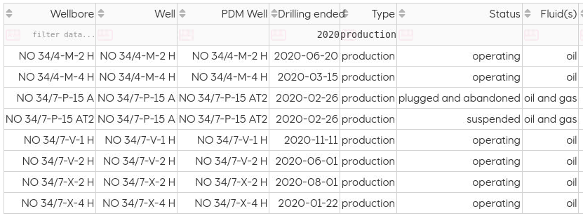
Exercise 5: Wellbore overview
Filter the table by typing in one or more of columns in the second row (filter data …)
Sort the table by clicking on the sorting icon in the column headers

Slide 24
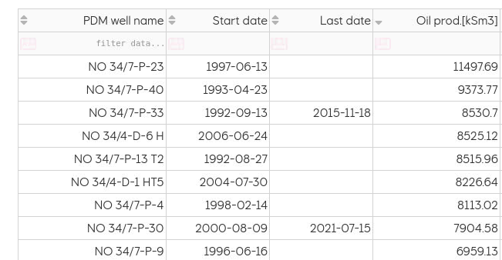
Exercise 6: Production/injection overview
Filter the table by typing in one or more of columns in the second row (filter data …)
Sort the table by clicking on the sorting icon in the column headers
Check that the reported volumes are consistent with the numbers reported in REP

Slide 25
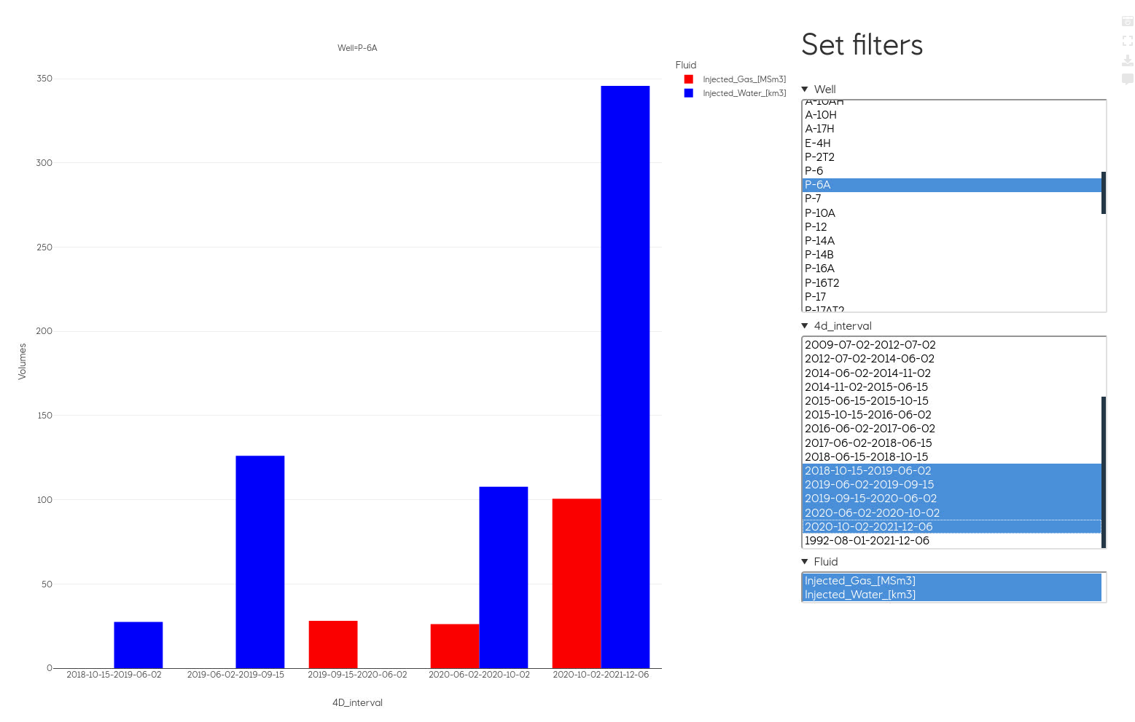
Exercise 7: Check the 4D response around well P-6A
Select Production/Injection plots – Injection plots

Slide 26
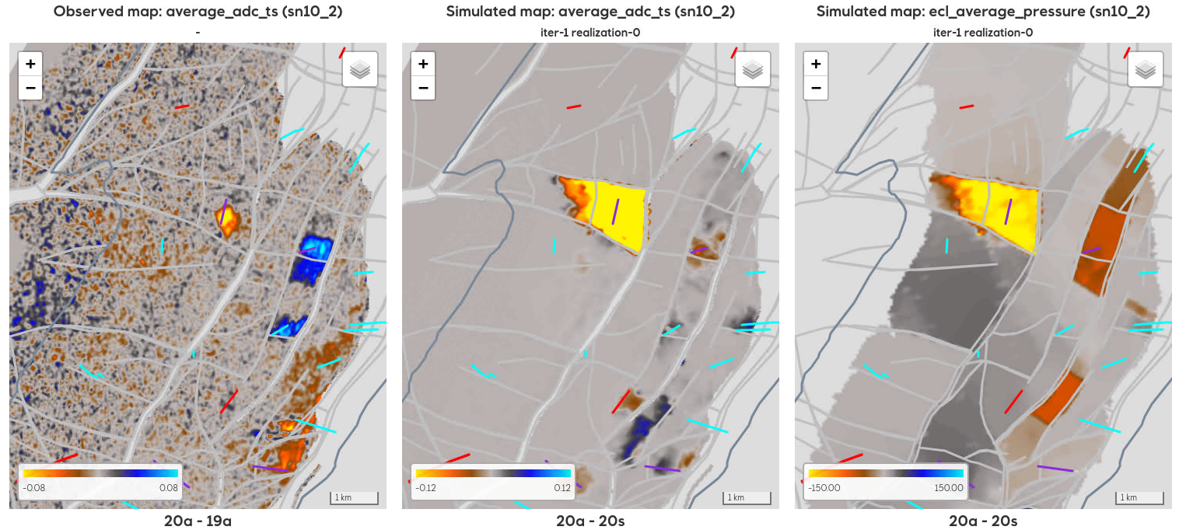
Exercise 7: Check the 4D response around well P-6A (cont.)
Select Timelapse maps – Observed and simulated maps
Toggle on well layer Injectors
Display the tooltip for the well within the pressure change anomaly
Check some the other realizations

